Slide 1
Module 8
ESRP Overview and Configuration
Notes:
This is the Module Title Page

Slide 2
Module Objectives
Describe ESRP in an overview
Discuss the Basics of ESRP and define EDP
Describe the Determination of ESRP Master
Discuss ESRP Tracking Information Option as a Master determinant
Define the Master Election Algorithm choices and when election occurs
Describe how to configure ESRP
Provide ESRP Example Configuration
Perform ESRP Lab Exercises
Summary
Notes:
This module describes the Extreme Standby Router Protocol (ESRP) and covers the following topics:
Describe ESRP in an overview
Basics of ESRP
Determining the ESRP master
Lab Exercise

Slide 3
ESRP Defined
ESRP - Extreme Standby Router Protocol
  It is an ExtremeWare feature
Enables multiple switches to provide routing redundancy at Layer 2 & 3.
Provides a way to keep host communications when a physical router becomes unavailable
Provides better resiliency than STP
Allows you to configure a virtual router on two or more Extreme switches belonging to the same network segment
ESRP is enabled on a per Vlan basis
Notes:
ESRP is a feature of ExtremeWare that allows multiple switches to provide redundant routing services to users. From the workstation’s perspective, there is only one default router (that has one IP address and one MAC address), so ARP cache entries in client workstations do not need to be refreshed or timed-out.
In addition to providing L3 routing redundancy, ESRP also provides for layer 2 redundancy. These “layered” redundancy features can be used in combination or independently. You do not have to configure the switch for routing to make valuable use of ESRP. The L2 redundancy features of ESRP offer fast failure recovery (usually 4 to 9 seconds) and provide for dual-homed system design. In some instances, depending on network system design, ESRP can provide better resiliency than using the Spanning Tree Protocol (STP).
The Extreme Standby Router Protocol (ESRP) provides a way to keep hosts communicating when a physical router becomes unavailable. ESRP works by allowing you to configure a virtual router on two or more Extreme switches that are part of the same network segment. Connected hosts are then configured using the IP address of the virtual router as the default gateway.

Slide 4
What is ESRP cont…
Only one of the virtual routers is active at any given time. This is called the Master or active router.
The other virtual routers remain in standby mode and do not route packets.
When an active router fails, one of the Slave or standby routers becomes the active router.

Slide 5
ESRP-Aware Switches
These are switches that are not running ESRP, but are connected on a network with Extreme switches running ESRP
Notes:
Extreme switches that are not running ESRP, but are connected on a network that has other Extreme switches running ESRP are called ESRP-aware. This means that when Extreme switches are attached to the ESRP-enabled switches, the non-ESRP switches reliably perform fail-over and fail-back scenarios in the prescribed recovery times. No configuration of this feature is necessary.
If Extreme switches running ESRP are connected to layer 2 switches that are not manufactured by Extreme Networks (or Extreme switches that are not running ExtremeWare 4.0 or above), the fail-over times seen for traffic local to the segment may appear longer, depending on the application involved and the FDB timer used by the other vendor’s layer 2 switch.
The VLANs associated with the ports connecting an ESRP-aware switch to an ESRP-enabled switch must be configured using an 802.1Q tag on the connecting port, or, if only a single VLAN is involved, as untagged using the protocol filter any. ESRP will not function correctly if the ESRP-aware switch interconnection port is configured for a protocol-sensitive VLAN using untagged traffic.

Slide 6
ESRP Basics
ESRP is configured on a per-VLAN basis on each switch
Maximum of four switches can participate in providing redundant layer 3 or layer 2 services to a single VLAN
  Only one switch can actively provide L3 and/or L2 switching for each VLAN.
  The switch performing forwarding for the VLAN is considered the “master”.
  Other participating switches (slaves) are in standby mode.
Maximum of 64 VLANs can run ESRP simultaneously on a single switch
Notes:
ESRP is configured on a per-VLAN basis on each switch. This is why this is more a Layer 2 implementation.
A maximum of four switches can participate in providing redundant layer 3 or layer 2 services to a single VLAN. A maximum of 64 VLANs can run ESRP simultaneously on a single switch (24 VLANs for EW Rel. 4.1+). The switches exchange keep-alive packets for each VLAN independently. Only one switch can actively provide L3 and/or L2 switching for each VLAN. The switch performing the forwarding for a particular VLAN is considered the “master” for that VLAN. Other participating switches (Slaves) for the VLAN are in standby mode.
For a VLAN with ESRP enabled, each participating switch uses the same MAC address and must be configured with the same IP address. It is possible for one switch to be master for one or more VLANs while being in standby for others, thus allowing the load to be split across participating switches.

Slide 7
Steps for 2+ Switches to do ESRP
Switches must have the ability to exchange packets on the same L2 broadcast domain for that VLAN
Assign the same IP address or IPX NETid for each separate switch
Enable ESRP on desired VLANs per switch
  ESRP cannot be enabled on VLAN “default”
EDP must be enabled on ports that are members of ESRP VLANs
  EDP - Extreme Discovery Protocol is enabled by default.
Notes:
To have two or more switches participate in ESRP, the following must be true:
For each VLAN to be made redundant, the switches must have the ability to exchange packets on the same Layer 2 broadcast domain for that VLAN. Multiple paths of exchange can be used, and typically exist in most network system designs that take advantage of ESRP.
In order for a VLAN to be recognized as participating in ESRP, the assigned IP address or the IPX NETid for the separate switches must be identical. Other aspects of the VLAN, including its name, are ignored.
ESRP must be enabled on the desired VLANs for each switch.
NOTE: ESRP cannot be enabled on the VLAN default.
EDP - Extreme Discovery Protocol, must be enabled on the ports that are members of the ESRP VLANs (The deault setting is enabled.). To verify EDP status, use the following CLI command:
show port <portlist> info

Slide 8
EDP Defined
The Extreme Discovery Protocol (EDP)
It is used to gather information about neighbor Extreme switches.
It is used by the switches to exchange topology information which includes:
  Switch MAC address (switch ID)
  Switch software version information
  Switch SystemName
  Switch VLAN-IP information
  Switch slot, port number
  Checksum, which checks for packet corruption
Notes:
SRCMAC = System MAC
DSTMAC = 00:e0:2b:00:00:00
SNAP Ethertype = 0x00BB
EDP Frames are sent out each port that it is enable on. These frames are sent at 60 second intervals.
EDP Packets have 2 formats, The General Info PDU and the VLAN Info PDU.
The General Info PDU is sent at first, if a neighbor switch is seen, then the Neighbors exchange VLAN Info PDU’s.
This is more efficient in the case of 3000 Vlans.

Slide 9
ESRP Switch Behavior
Master Switch
  Actively provides L3 routing services to other VLANs & L2 switching between all ports of VLAN
  It also exchanges ESRP packets with other standby mode switches
Standby Switch
  Exchanges packets with other switches on the same VLAN
  In L3, marks router interface associated with the VLAN as down
  In L2, no forwarding occurs between member VLAN ports; preventing loops and maintains redundancy

Slide 10
Determining the ESRP “Master”
In The Order Of Precedence
Active Ports:
  Number of active physical links involved in serving the VLAN
  Switch with greatest number of links takes highest precedence.
Tracking
  This is used to track various forms of connectivity from the ESRP switch to the outside world.
Priority
  The ESRP priority: is set at 0 by default. Configurable from 1- 255 with higher number taking priority. If priority is set to 255, the switch will remain in standby mode even if master fails.
MAC Address
  Switch with higher MAC address has priority
Notes:
The ESRP master switch (the one providing L3 routing and/or layer 2 switching services for a VLAN) is determined by the following factors, listed in order of precedence:
The number of active physical links involved with servicing that particular VLAN
The switch that has the greatest number of links takes highest precedence. A load-sharing port group is considered a single link. If the number of links are equal, the next factor is used.
virtual router PRIORITY -
This is a user-defined field. The range of the priority value is 0 to 255; a higher number has higher priority. The default priority setting is 0. If priorities are equal, the last factor is used.
internal MAC address
The higher MAC address has priority
Router priority is the only configurable parameter. With all things equal, the master router/switch is selected by way of the internal MAC address.

Slide 11
Determining the ESRP “Master”
ESRP Tracking Information Options
VLAN Tracking
  Tracks active port connectivity to one or more specified VLANs
Ping Tracking
  Tracks ICMP ping connectivity to specified devices.
IP Route Table Tracking
  Tracks specified learned routes from IPR
Diagnostics Tracking
  Diagnostics being run or failing will cause a fail over.
Health Checking Tracking
  Lost PSU, Fan Failure, etc. will cause fail over.
Notes:
VLAN: Tracks active port connectivity to 1 or more VLANS.
Note: Load share ports are not counted as a single port, if four ports are participating, ESRP sees them as four ports. If one of the four fails, a fail over will occur.
Ping: Tracks ICMP ping connectivity to specified devices.
IP Route Table: Tracks specified learned routes from IPR
ESRP is now capable of tracking hardware status. If a power supply or fan fails, or if the chassis is overheating, the priority for the ESRP VLAN will change to the failover settings. ESRP will also track the diagnostics that run on each blade. If the diagnostics fail the ESRP VLAN will change the priority to the failover settings.
Diagnostics: Diagnostics being run or failing will cause a fail over.
Health Checking: Lost PSU, Fan Failure, etc. will cause fail over.

Slide 12
Master Election Algorithms
The switch can be configured using 1 of 5 election algorithms to select ESRP Master:
  Ports_Track_Priority_Mac (default)
  Track_Ports_Priority_Mac
  Priority_Ports_Track _Mac
  Priority_Track_Ports_Mac
  Priority_Mac_Only
Note:
  Only the default Ports_Track_Priority_Mac is compatible with ExtremeWare prior to release 6.0.

Slide 13
Ways of Electing the Master Switch
A communicated parameter change
Loss of communication between master and slave/s
Notes:
A new master can be elected in one of the following ways:
A communicated parameter change
Loss of communication between master and slave(s)
If a parameter that determines the master changes (for example, link loss or priority change), the election of the new master typically occurs within one timer cycle (2 seconds by default). If a switch in standby mode loses its connection with the master, a new election (using the same precedence order indicated previously) occurs. The new election typically takes place in three times the defined time cycle (6 seconds by default).

Slide 14
Factors in Determining Fail-over Time
The ESRP timer setting
The Routing protocol being used for inter-router connectivity if Layer 3 redundancy is used
Notes:
Fail-over time is largely determined by the following factors:
The ESRP timer setting
The routing protocol being used for inter-router connectivity if Layer 3 redundancy is used. OSPF fail-over time is faster than RIP fail-over time.
The Fail-over time associated with the ESRP protocol is dependent on the timer setting and the nature of the failure.The default timer setting is 2 seconds; the range is 1 to 255 seconds. Default settings usually result in a Fail-over time of 5 t0 8 seconds.
If routing is configured, the Fail-over of the particular routing protocol (such as RIP V1, RIP V2, or OSPF) is added to the Fail-over time associated with ESRP.

Slide 15
Grouping Blocks of 10/100 Ports
Summit non-i-based Restriction
All VLANs using a port or port-block must enable ESRP
  If you enable ESRP on a VLAN that contains 10/100 ports, a specific block of neighboring ports must also be participating in a VLAN running ESRP, or must not be used.
The blocks of ports are physically adjacent, regardless of the switch or module port numbering scheme.
Notes:
These restrictions do not apply on I-based switch products.
If you enable ESRP on a VLAN that contains 10/100 ports, a specific block of neighboring ports must be participating in a VLAN running ESRP, or must not be used. The block of ports are physically adjacent, regardless of the switch module. For example, the blocks on a BlackDiamond F32T module consist of the following:
Ports 1-4 and 17-20
Ports 5-8 and 21-24
Ports 9-12 and 25-28
Ports 13-16 and 29-32

Slide 16
ESRP Example
Server
10.10.10.1
%1234
Summit
Summit
1
3
2
3
5
6
Workstation
10.10.10.1
%9876

Slide 17
ESRP Example cont...
Server
10.10.10.1
%1234
Summit
Summit
1
3
1
8
2
3
4
5
6
7
Workstation
10.10.10.1
%9876

Slide 18
ESRP cont…
In order for a workstation to talk to the router, it must know the router’s MAC address even though it knows about the IP address.

Slide 19
ESRP: L2 Forwarding Example
Server
10.10.10.1
MAC: 00:E0:2B:00:00:00
Summit
Summit
1
3
1
8
2
3
4
5
6
7
Workstation
10.10.10.1
MAC: 00:E0:2B:00:00:00

Slide 20
ESRP Commands
enable/disable esrp vlan <name>
config vlan <vlan name>
  [ esrp-election | group | priority | timer ]
show esrp <name> <all> <cr>
  [ detail | vlan <vlan name> | <cr> ]
Notes:
enable esrp vlan <name>
Enables ESRP on a VLAN
disable esrp vlan <name>
Disables ESRP on a VLAN
config vlan <vlan name> esrp group <number>
config vlan <vlan name> esrp priority <value>
Configures the ESRP priority. The range is 0 to 255. The higher number has higher priority. The default setting is 0.
config vlan <vlan name> esrp timer <hello_timer>
Configures the time between ESRP updates. The range is 1 to 255 seconds. The default setting is 2 seconds. The timer setting must be configured identically for the VLAN across all participating switches.
Hello_timer is a protocol
show esrp <vlan name> <all> <cr>

Slide 21
CLI Command – enable esrp
enable esrp vlan <vlan name>
disable esrp vlan <vlan name>
  Enables or disables ESRP on a per vlan basis.
  ExtremeWare supports 64 instances of ESRP-enabled VLANs per switch.

Slide 22
CLI Command – configure vlan esrp
ESRP election algorithm
config vlan <vlan name> esrp esrp-election [ ports-track-priority-mac | priority-mac-only | priority-ports-track-mac | priority-track-ports-mac | track-ports-priority-mac ]
  Configures the election algorithm on the switch. The algorithm must be the same on all switches for a particular VLAN. You need to specify one of five from the following algorithms:
    ports-track-priority-mac ⬅ Default setting
    priority-mac-only
    priority-ports-track-mac
    priority-track-ports-mac
    track-ports-priority-mac
  If no tracking information is configured for a particular field, it is ignored.

Slide 23
Example Tracking Configuration
VLAN Tracking
  create Vlan extra
  conf Extra ipa 50.0.0.1/24
  conf extra add po 2
  conf ISP_vlan add track-vlan extra
Ping Tracing
  Conf ISP-vlan add track-ping 20.0.0.101 frequency 3 miss 2

Slide 24
CLI Command – configure vlan esrp
Group
config vlan <vlan name> esrp group <group_number>
  Configures the virtual MAC address to be used for the ESRP VLAN.
  Default group number is 0.

Slide 25
CLI Command – configure vlan esrp
Priority
config vlan <vlan name> esrp priority <number>
  Configures the ESRP priority. The range is 0 to 255. The higher number has higher priority.
  The default priority setting is 0.
  A priority setting of 255 configures the switch to be in standby state.

Slide 26
CLI Command – configure vlan esrp
Timer
config vlan <vlan name> esrp timer <number>
  Configures the time between ESRP updates. The range is 1 to 255 seconds.
  The timer setting must be configured identically for the VLAN across all participating switches.
  Default timer setting is 2 seconds.

Slide 27
CLI Command – show esrp
show esrp [ detail | vlan <vlan name> | <cr> ]
    Displays ESRP-enabled VLANs configuration information for one or all VLANs.
show esrp-aware [ vlan <vlan name> | <cr> ]
    Displays ESRP-aware (non-ESRP enabled VLANs) configuration information

Slide 28
Example Display “Show ESRP Detail”
* Internet-Alpine:6 # show esrp detail
VLAN Interface: sample_vlan Virtual IP address=216.52.8.25
Priority: 0 (Priority In Use: 0)
Active Ports: 1
Tracked Rt/Ping: 0
Tracked Ports: 0
Tracked Diag: -
Tracked Env: -
Election Algorithm: ports-track-priority-mac
Group: 0
Hello Timer: 2
State: Enabled(Master) on Thu Feb 8 11:34:13 2001
State Trans Counters: ToMaster:(3) ToSlave:(2)
Host ports(*=no-count): None
Restart Ports: None
Tracked VLANs: None
Tracked Ip Routes: None
Tracked Pings/Freq/N_miss: None
Neighbours: None
Host (Direct-attach, *=no-count) Ports on System:1:20**

Slide 29
More ESRP Configuration Commands EDP Related Commands
enable/disable edp ports [ all | <port number> ]
  Enables/disables the generation and processing of EDP messages on one or more ports.
  The default setting is enabled.
show edp [ <port number> | <cr> ]
  Displays EDP information.

Slide 30
Steps for Setting up ESRP
Check to make sure EDP is enabled for all ports in the vlan with the CLI command:
  show port <portlist> info
Configure ESRP parameters
Execute the command:
  enable esrp vlan <vlan name>
Notes:
EDP - Extreme Discovery Protocol is Extreme’s proprietary protocol between switches and is on by default on all Gigabit ports.
EDP must be enabled o the ports that are members of the ESRP VLANs

Slide 31
ESRP: Things to Remember
EDP (Extreme Discovery Protocol) must be enabled in order for ESRP to work.
Highly Recommend: Devices must connect to all ESRP routers in the same group,
  i.e. if there are three ESRP routers, each device must connect to all three ESRP routers.
Notes:
Must be enabled in blocks of 8 10/100 ports.(Application for non-I-based switched only)
EDP (Extreme Discovery Protocol) must be enabled in order for ESRP to work.
Highly Recommend: Devices must connect to all ESRP routers in the same group,
i.e. if there are three ESRP routers, each device must connect to all three ESRP routers.

Slide 32
Lab15 - ESRP Layer 2 Configuration
Create the REDISH and configure ports and ip address accordingly
Familiarize yourself with ESRP CLI configuration commands as follows:
  enable/disable esrp vlan <name>
  config vlan <vlan name>
    [ esrp-election | group | priority | timer ]
  show esrp <name> <all> <cr>
    [ detail | vlan <vlan name> | <cr> ]
Notes:
Reference the lab procedures provided by the Student Guide and what to do from the instructor.

Slide 33
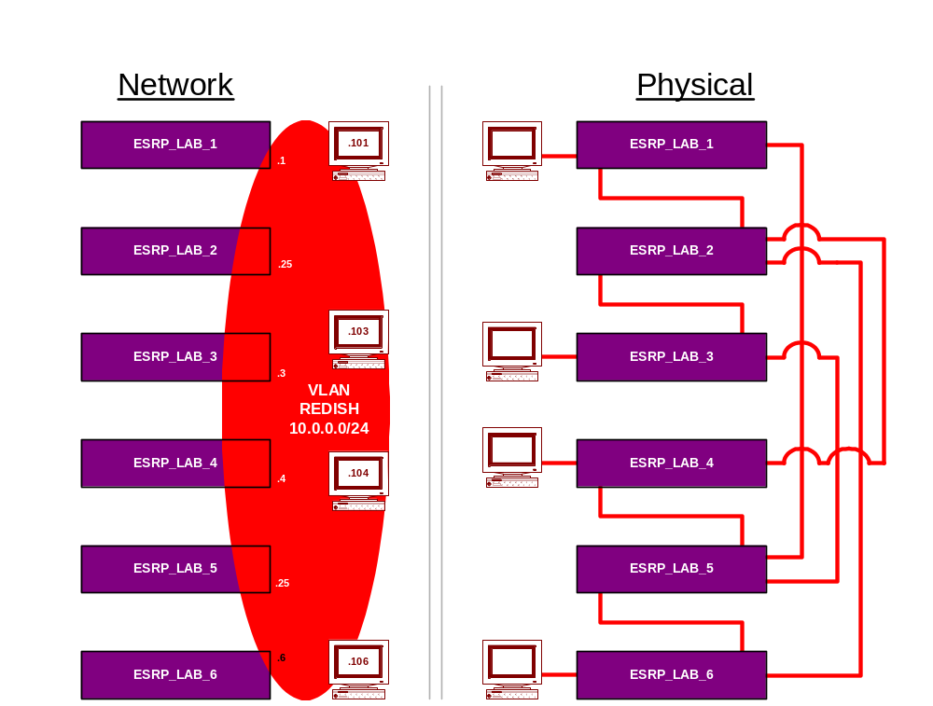
Lab15 - Network Topology (a)

Slide 34
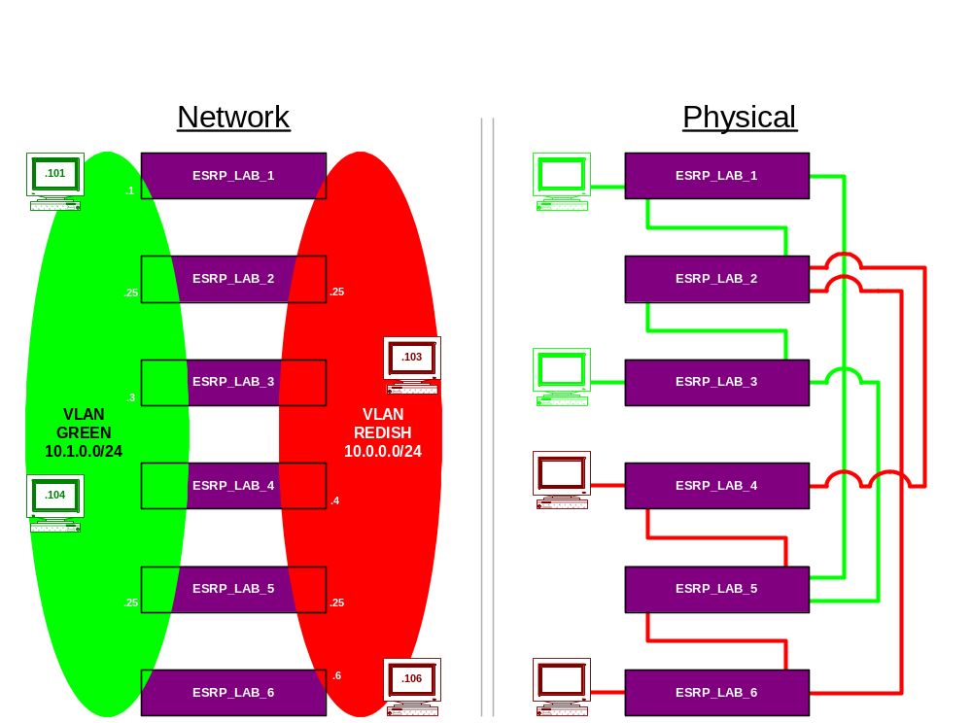
Lab15 - Network Topology (b)
Notes:
Shown is the second part of the Lab procedures topology.

Slide 35
Other ESRP Options
ESRP Host Attach
ESRP Domains
ESRP Groups
Linking ESRP Switches
Configuring ESRP and Multinetting
ESRP and Spanning Tree

Slide 36
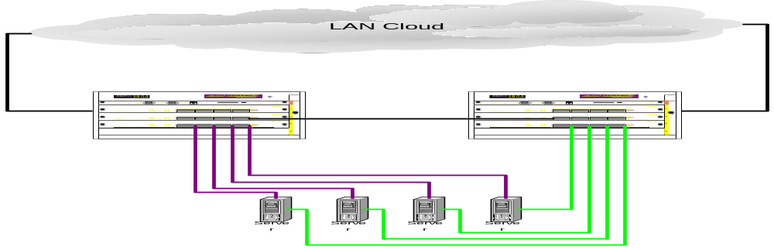
Other ESRP Options
ESRP Host Attach (HA)
LAN Cloud
Allows active hosts to be connected directly to an ESRP Master or standby (slave) switch.
Allows configured ports that do not represent loops, to continue L2 operation independent of ESRP status.
Notes:
ESRP Host Attach (HA) is an optional ESRP configuration that allows active hosts to be connected directly to an ESRP Master or standby (slave) switch. Normally, the Layer 2 redundancy and loop prevention capabilities of ESRP do not allow packet forwarding from the standby ESRP switch.
ESRP HA allows configured ports that do not represent loops to the network to continue L2 operation independent of their ESRP status.
It is useful if you are using dual-homed network interface cards (NICs) for server farms, and in conjunction with high availability server load balancing (SLB) configuration as displayed.

Slide 37
Other ESRP Options
ESRP Domains
ESRP only allows 64 instances so if somebody wants to do more, you need domains to do the 65th.
Allows multiple VLANs to be grouped under the control of single instances of the ESRP protocol.
All Vlans in this particular group share the same Master and Slaves.
ESRP domain member VLANs max. = 3000
Notes:
This feature allows multiple Vlans to be grouped under the control of single instances of the ESRP protocol. All Vlans in this particular group share the same Master and Slaves. ESRP only allows 64 instances so if somebody wants to do more you need domains to do the 65th.
Note : This feature requires the I chipset.
Increased Number of ESRP Domain Member VLANs
The maximum number of ESRP domain member VLANs is now 3000.
To configure 3000 ESRP VLANs, you must first disable support for non “i” chipset products using the following command:
disable g1-module-support
You must then set the CPU transmit priority to normal, using the following command:
configure cpu-transmit-priority normal
After these two changes you can configure up to 3000 ESRP VLANs.

Slide 38
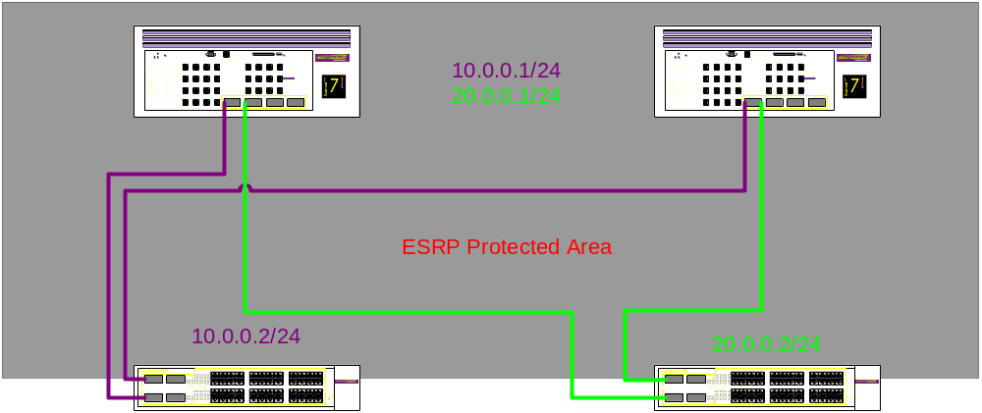
Example ESRP Domain Configuration
Notes:
The configuration commands in the above example may be the following:
create vlan purple
create vlan green
conf purple ipa 10.0.0.1/24
conf green ipa 20.0.0.1/24
conf default del po all
conf purple ad po 29
conf green add po 30 t
conf purple add domain-member green
enable ipf
enable esrp purple
In this Example:
ESRP fails based on the purple vlan since there is only one port in Purple and it did not fail Gree, it lost connectivity and did not fail over. Now add a Tag of 10 to Purple and add the other port (green) tagged to the purple vlan and watch what happens.

Slide 39
Other ESRP Options
ESRP Groups
Allows running multiple instances of ESRP within the same VLAN or broadcast domain.
Most typical application for multiple ESRP groups
  when two or more sets of ESRP switches are providing fast-failover protection within a subnet.
Up to four distinct ESRP groups can be supported
  within the same networked broadcast domain.
Configure ESRP group membership for a VLAN on a switch with the CLI command:
  config vlan <name> esrp group <group number>
NOTE:
  A switch cannot perform both master and slave functions on the same VLAN for separate intances of ESRP
Notes:
ExtremeWare supports running multiple instances of ESRP within the same VLAN or broadcast domain. This functionality is called an ESRP group. Though other uses exist, the most typical application for multiple ESRP groups is when two or more sets of ESRP switches are providing fast-failover protection within a subnet. A maximum of four distinct ESRP groups can be supported within the same networked broadcast domain.
To configure the ESRP group membership for a VLAN on a switch, use the following command:
config vlan <name> esrp group <group number>
The default group number is 0.
Note: Requires I chipset

Slide 40
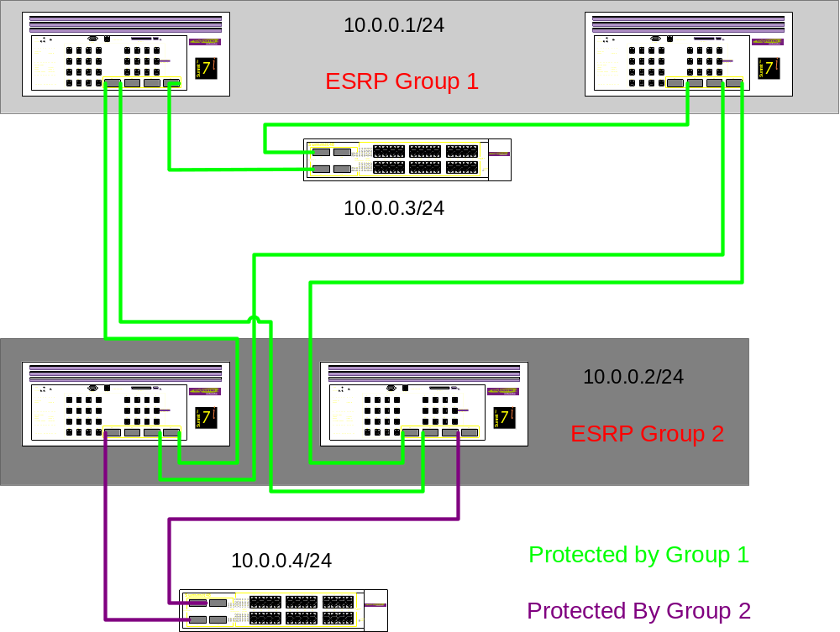
Other ESRP Options - Example ESRP Groups
Notes:
To configure the above the CLI commands would be:
Cre vlan purple
Conf purple ipa 10.0.0….
Con purple add ports all
Conf purple esrp-group 1(for 10.0.0.1)
Conf purple esrp-group 2(for 10.0.0.2)
Enable esrp purple

Slide 41
Other ESRP Options
Linking ESRP Switches (Direct Links)
Can provide a more direct routed path
  The link can contain a unique router-to-router VLAN/subnet
Can be used as a highly reliable method to exchange ESRP hellos
It is necessary when using the ESRP HA option
  It is used to provide Layer2 forwarding services through an ESRP standby switch.
Notes:
When considering system design using ESRP, direct links between ESRP switches are useful under the following conditions:
A direct link can provide a more direct routed path, if the ESRP switches are routing and supporting multiple VLANs where the master/standby configuration is split such that one switch is master for some VLANs and a second switch is master for other VLANs. The direct link can contain a unique router-to-router VLAN/subnet, so that the most direct routed path between two VLANs with different master switches uses a direct link, instead of forwarding through another set of connected routers.
A direct link can be used as a highly reliable method to exchange ESRP hellos, so that the possibility of having multiple masters for the same VLAN is lessened, should all downstream Layer2 switches fails.
A direct link is necessary when using the ESRP HA option. The direct link is used to provide Layer2 forwarding services through an ESRP standby switch.
Direct links may contain a router-to-router VLAN, along with VLANs running ESRP. If multiple VLANs are used on the direct links, use 802.1Q tagging. The direct links may be aggregated into a load-shared group, if desired.

Slide 42
ESRP Cautions
ESRP should not be enabled on a VLAN that is exchanging routes with other non ESRP routers that use routing protocols like OSPF or RIP.
  ESRP could interfere with normal routing communication if an ESRP enabled VLAN contains other routers not using ESRP.
ESRP and Multi-netting:
  When ESRP and IP Multi-netting are on the same switch, the ESRP switches must be configured Identically; ie. Number of links, priority settings, timers, etc.
ESRP and Spanning Tree:
  Cannot be combined on the same switch.
    Other switches in VLANS supported by the ESRP switch may run STP, because ESRP forwards, but not filters. ESRP and STP must be on separate physical devices.
Notes:
Configuring ESRP & Multinetting On A Switch
The parameters that affect the determination of the ESRP Master must be configured identically for all VLANs involved with IP multinetting.
Example parameters that must be identical for all affected VLANs are:
Number of links in your configuration
Priority settings
Timer settings
ESRP and Spanning Tree On The Same Switch
ESRP and Spanning Tree should not be enabled on the same VLAN/s
Other switches in the VLAN being protected by ESRP may run STP and the switch running ESRP forwards, but does not filter STP BPDUs.
Hence, you can combine ESRP and STP on a network and a VLAN, but they must be running on separate devices.
Care must be taken in maintaining ESRP connectivity between ESRP master and standby switches

Slide 43
ESRP and VLAN Aggregation
ESRP can be used to provide redundant default router protection to VLAN aggregation clients.
ESRP is enabled only on the super-VLAN (not the sub-VLANs)
You need to add ports to the super-VLAN that is shared with the sub-VLANs. In order to do this
  Configure the super-VLAN with an 802.1Q tag
  Configure the suoer-VLANs ports as tagged to avoid protocol conflict.
  Enable ESRP on the super-VLAN

Slide 44
Lab16 – ESRP Layer 3 Configuration
Configure four switches as shown in the next page.
Utilize ESRP configuration commands:
  Config vlan ESRP ESRP-Election Priority-Ports-Track-Mac
  Config vlan ESRP Priority
  Enable ESRP
  Show edp
  Show esrp detail

Slide 45
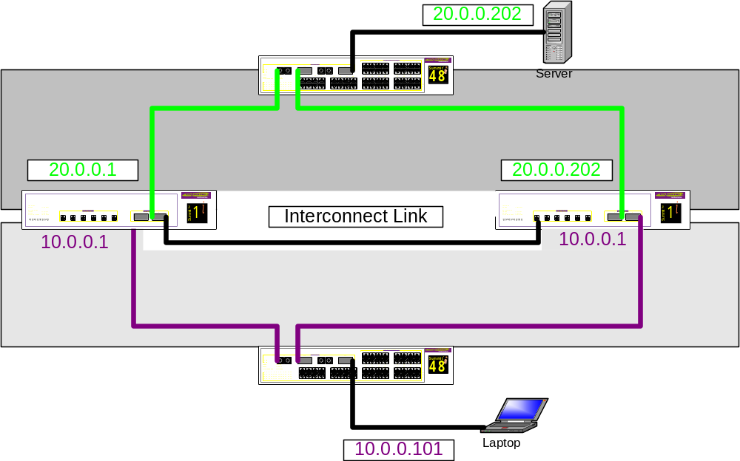
Lab16 – Network Topology

Slide 46
Lab16 - Answers
Slave
Create Vlan Purple
Create Vlan Green
Config Purple Ipaddress 10.0.0.1/24
Config Green Ipaddress 20.0.0.1/24
Config Default del ports all
Config Purple add port 1
Config Green add port 2
Config Purple tag 10
Config Green tag 20
Config Purple add port 3 tag
Config Green add port 3 tag
Config Purple ESRP ESRP-Election Priority-Ports-Track-Mac
Config Green ESRP ESRP-Election Priority-Ports-Track-Mac
Config Purple ESRP Priority 100
Config Green ESRP Priority 100
Enable ESRP Purple
Enable ESRP Green
Save config Primary
Master
Create Vlan Purple
Create Vlan Green
Config Purple Ipaddress 10.0.0.1/24
Config Green Ipaddress 20.0.0.1/24
Config Default del ports all
Config Purple add port 1
Config Green add port 2
Config Purple tag 10
Config Green tag 20
Config Purple add port 3 tag
Config Green add port 3 tag
Config Purple ESRP ESRP-Election Priority-Ports-Track-Mac
Config Green ESRP ESRP-Election Priority-Ports-Track-Mac
Config Purple ESRP Priority 200
Config Green ESRP Priority 200
Enable ESRP Purple
Enable ESRP Green
Save config Primary

Slide 47
Lab16- Alternatively…
Another way to have completed this exercise :
  Create an additional VLAN in between the two switches and run a routing protocol between them.
  This would keep the split-brain from occurring.
  You would not run ESRP on this VLAN though.

Slide 48
LAB16 – Continuing on with the setup - OPTIONAL
Continuing with Lab16 current setup:
  Add the tracking feature Track-VLAN.
  The goal here is that if the Green VLAN were to fail over, the purple one would upon seeing the failure, fail over as well.
Test the configuration:
  Do a continuos PING from server to end user.
  Pull the link on the Green VLAN to the Master switch.
    You then should see one switch as Master for Purple and the other as Master for Green with traffic still passing.
  Plug the link back in and configure the Purple VLAN to track the Green.
Now when you pull the link from Green to the Master switch, Purple should fail over to the Slave switch along with Green.
Notes:
Time permitting, you can do this one.

Slide 49
Summary
Describe ESRP in an overview
Discuss the Basics of ESRP and define EDP
Describe the Determination of ESRP Master
Discuss ESRP Tracking Information Option as a Master determinant
Define the Master Election Algorithm choices and when election occurs
Describe how to configure ESRP
Provide ESRP Example Configuration
Perform ESRP Lab Exercises

Slide 50
This page is left intentionally blank.

